Slide 1
CRM LOGISTICS & COMPLIANCE MANAGEMENT
SPE CONSULTING

Slide 2
Project Overview
SPE
Consulting
Tasty Treats Corporation originally contacted SPE consulting upon being acquired by Royal Foods.
Royal foods was focused on understanding TTC’s operations by taking a hands off approach.
Royal Foods has been anxiously waiting to accelerate its return on investment.
Royal Foods wished to prepare the label for a national scale and introduce their company to the American market.

Slide 3
Tasty Treats Corporation Objectives
SPE
Consulting
Implement a multi-tier application which would facilitate customer relationship management for its multiple sales channels and operations.
To comply with emerging European regulations
Create daily automated reports for Royal Foods business intelligence systems.

Slide 4
Workstream I:CRM
SPE
Consulting
CRM application appropriate for SMB market
TTC’s sales team
Run inside a firewall
Sensitive customer data
Integrate with Microsoft Exchange/Outlook
Facilitate mobile access for TTC’s sales team
Reporting functionalities and forecasting

Slide 5
Workstream I CRM Solutions
SPE
Equipping the Sales team with the right tools they need to be effective in the field
SalesForce CRM
Cloud Computing, information accessibility anywhere in the world
Secure, IP verification, multiple layers of security
Forecasting, custom dashboard
Contacts, Lead tracking
Mobile Platform, iPhone with SF software app
MS Exchange for Outlook sync
Consulting

Slide 6
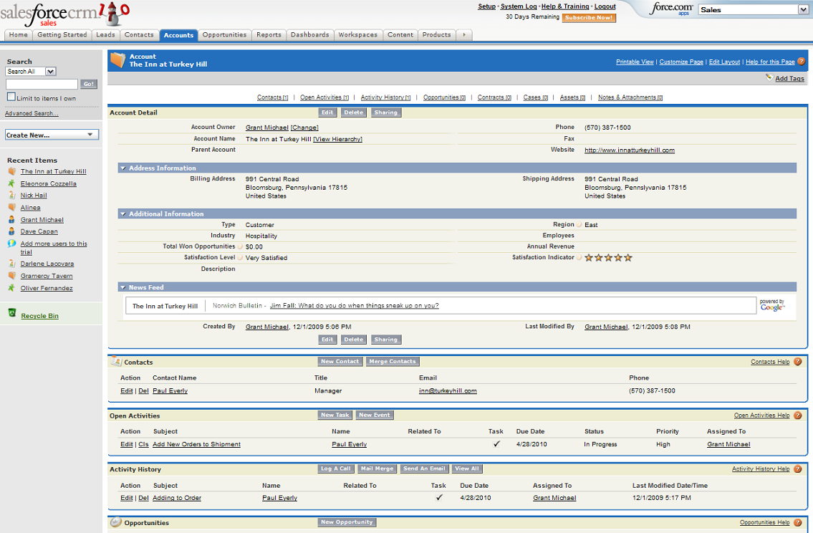

Slide 7
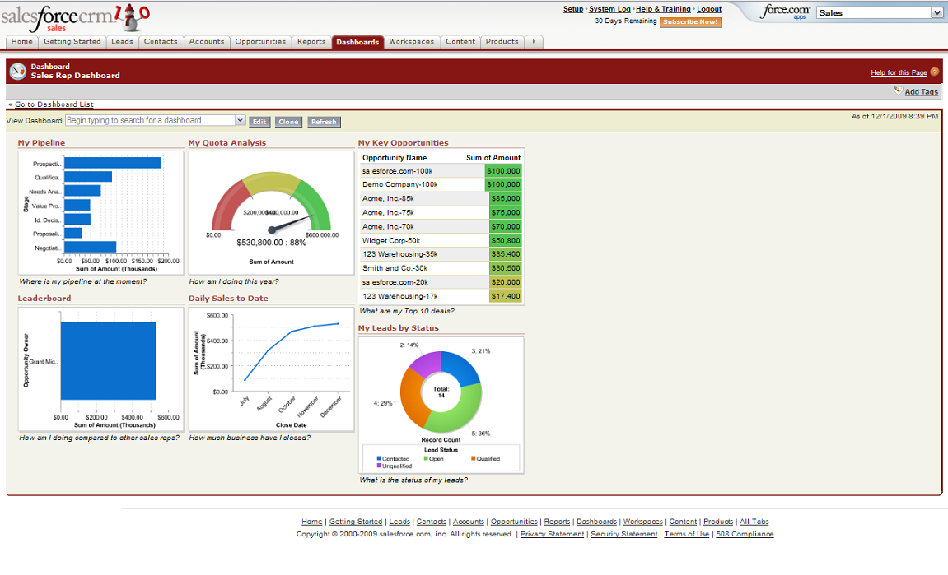

Slide 8
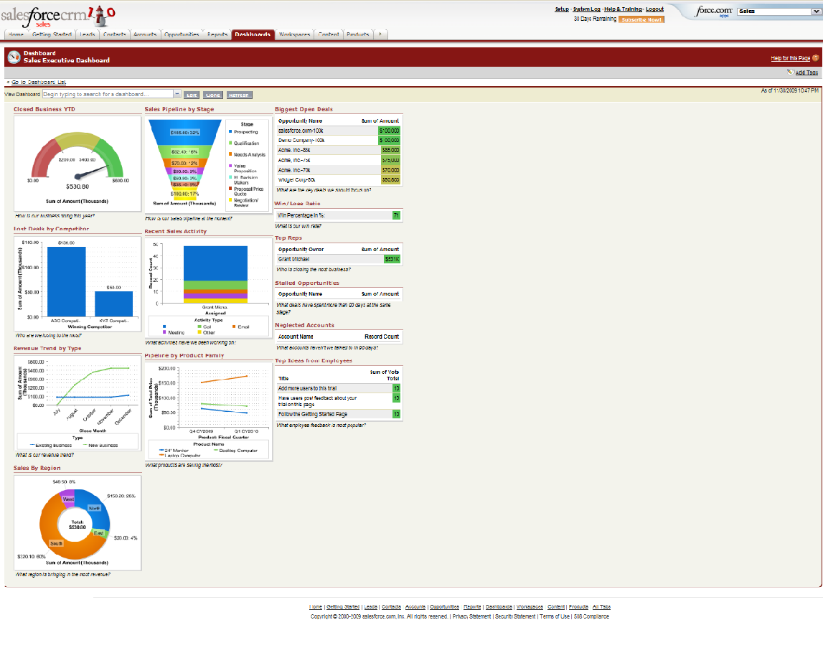

Slide 9
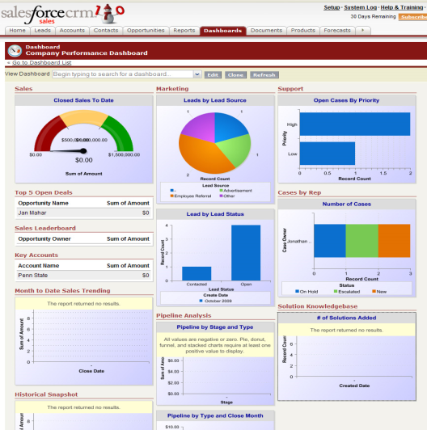
Workstream I CRM Solutions
SPE
Consulting
SalesForce App Exchange
3rd party applications just like the App Store
V2i- Voice2Insight
App lets you update your SalesForce contacts and leads on the go, wirelessly from your phone, anywhere in the world

Slide 10
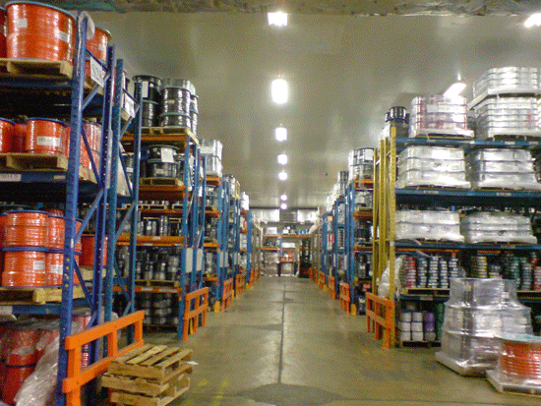
Workstream II: Logistics Management
SPE
Billing and order management
Integration with wireless reporting tools
Product tracking
Streamline communication
Automatic fulfillment process
Shipment status
Warehouse management
Consulting

Slide 11
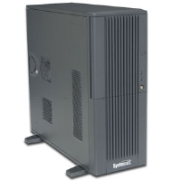
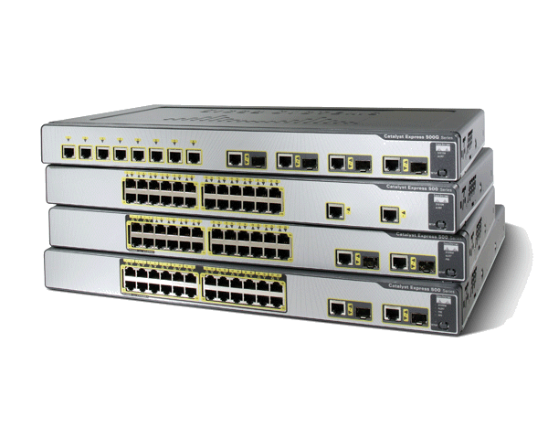
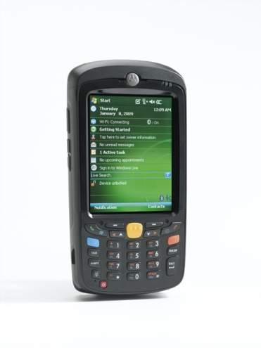
Workstream II: Logistics Management Solutions
SPE
Consulting
Complete overhaul of TTC’s warehouse management infrastructure
SPE Consultants implemented a comprehensive logistics system into all of TTC’s warehouses and production facilities

Slide 12
We installed into each:
Database servers
Oracle Warehouse Mgmt Software
3com Wireless Access Points (5 per)
Enterprise Digital Assistants with integrated barcode scanners (200 total)
Cisco switches
Allows TTC’s warehouses & production facilities to track, restock, & manage everything coming in & going out, all in real time
SPE
Consulting

Slide 13
Workstream III: Regulatory Compliance
SPE
TTC will provide business metrics to RF for European compliance processes.
Transaction information should be provided daily
The following metrics are required:
Transaction, Customer, Profit & Loss information provided daily
Customer information, profits provided at end of month
Metrics need to be automated & integrated
Consulting

Slide 14
SPE
Outbound Hub
A separate team from TTC learned of Regulatory Compliance workstream and discovered more about the objectives, they realized that the infrastructure that was being built for EU compliance could feed their BI reporting application with similar metrics.
iBolt is used to integrate the various software automatically
Synchronizes information between company departments
Consulting
Notes:
Can contain multiple feeds from multiple sources. Allows for constant expansion and growth.

Slide 15
Workstream III and outbound solutions
SPE
Consulting
SPE Consultants has provided a comprehensive solution that will benefit TTC right now and in the future as the company continues to grow.
Magic Software’s iBolt is a software platform and interface allows the automated interaction between a vast majority of ERP software programs including SAP, Oracle, and SalesForce
It also enables metric reporting and communication to and from different enterprise programs in real time

Slide 16
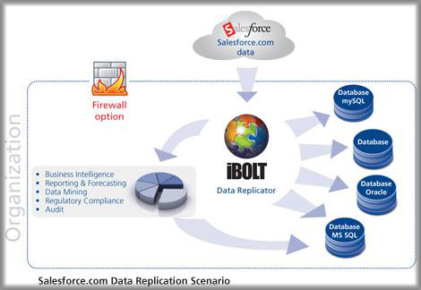
SPE
Workstream III and outbound solutions
Consulting
We believe that this was one of the best solutions which also turned out to greatly benefit TTC when the PCR was put in for a second feed in iBolt’s Outbound Hub.
In the future, as TTC expands, additional feeds can be easily implemented and managed through iBolt’s interface with an incredibly small “integration footprint”

Slide 17
Project Financials
Original Budget Estimate: $652,000
Project Cost Breakdown
Outbound Hub Financial Breakdown
Basis for Project Benefits

Slide 18
Problems Encountered & Risks
SPE
Risks:
Security issues
System failures
Employee Rejection
Efficiency & Profitability
Budget Constraints
Consulting
Problems Encountered:
No previous CRM
Financial information
Handheld performance issues
Employees adapting to new system

Slide 19
Lessons Learned
SPE
Consulting
Having a good project manager was necessary for project success
Teamwork was vital for project success
Our planning helped is in the long run
Project management software was very helpful

